Slide 1
Data Visualisation Design Project
January ’23 Term
Exploratory Data Analysis and Visualising
iHerb Face Masks Data
By: Group 6
Deeksha Chutani, 21F1002583
Param Chordiya, 21F1003953
Shagun Dwivedi, 21F1001731
Shaifali Vashishtha, 21F1003257

Slide 2
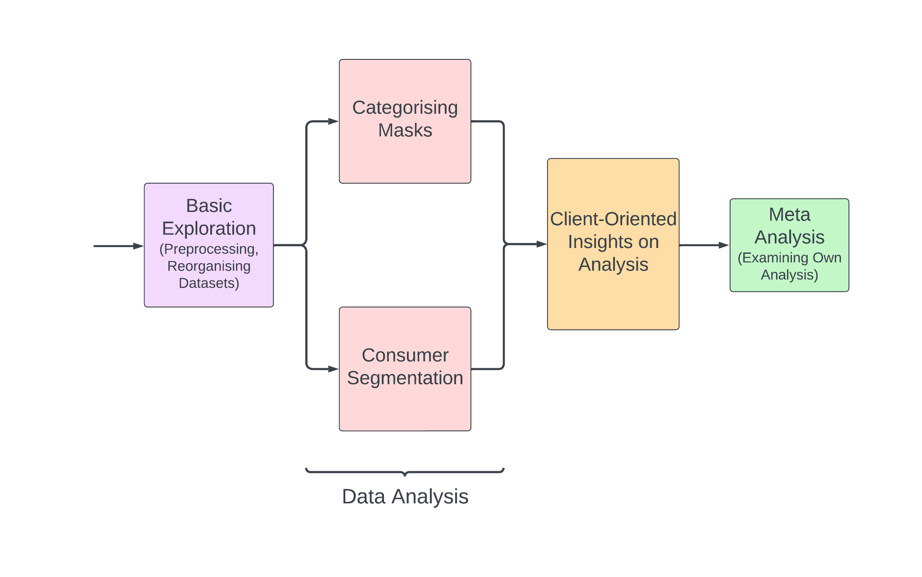
Abstract
Objective:
Analyze mask related datasets
Gain insights about the competition
To help improve marketing strategy and R&D.
Approach:
Categorised the problem statement into four parts:
Selected Tools based on our needs:
Type and Extent of Preprocessing
Types of Visualisation
Performed sanity checks on the results at various stages of the process.
Interpreted the visualisations into meaningful insights.
Built a presentable narrative around the data.

Slide 3
—John Tukey
“An approximate answer to the right problem is worth a good deal more than an exact answer to an approximate problem.”

Slide 4
Let’s Find the Right Problems
01
02
03
04
Popular Masks
Consumer Preference
Consumer Profiles
Additional Data
05
06
07
Key Findings
Analysis Constraints
Suggestions
What are their key features?
What do they like about the masks?
How do we segment them?
How to get more insights into the consumers?
What are the implications for the client?
Can we make some improvements?
What other features could improve the datasets?

Slide 5
01
What are the Most Popular Masks?
What are their Key Features?

Slide 6
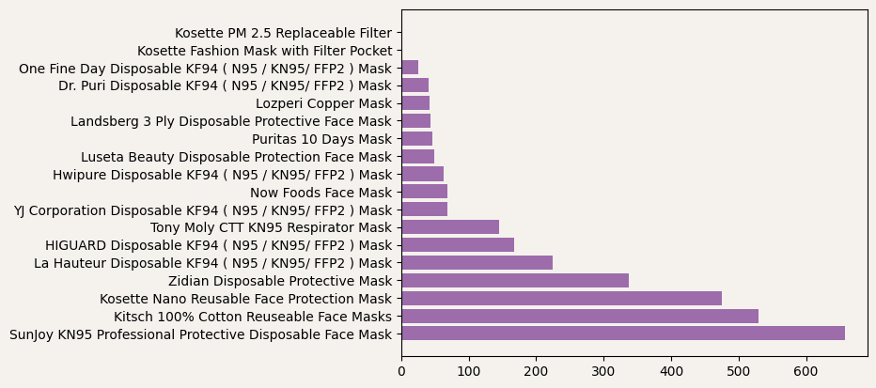
Popularity Based on Number of Reviews – Initial Visualisation
01. Most Popular Masks
But, some products differ on specific features.

Slide 7
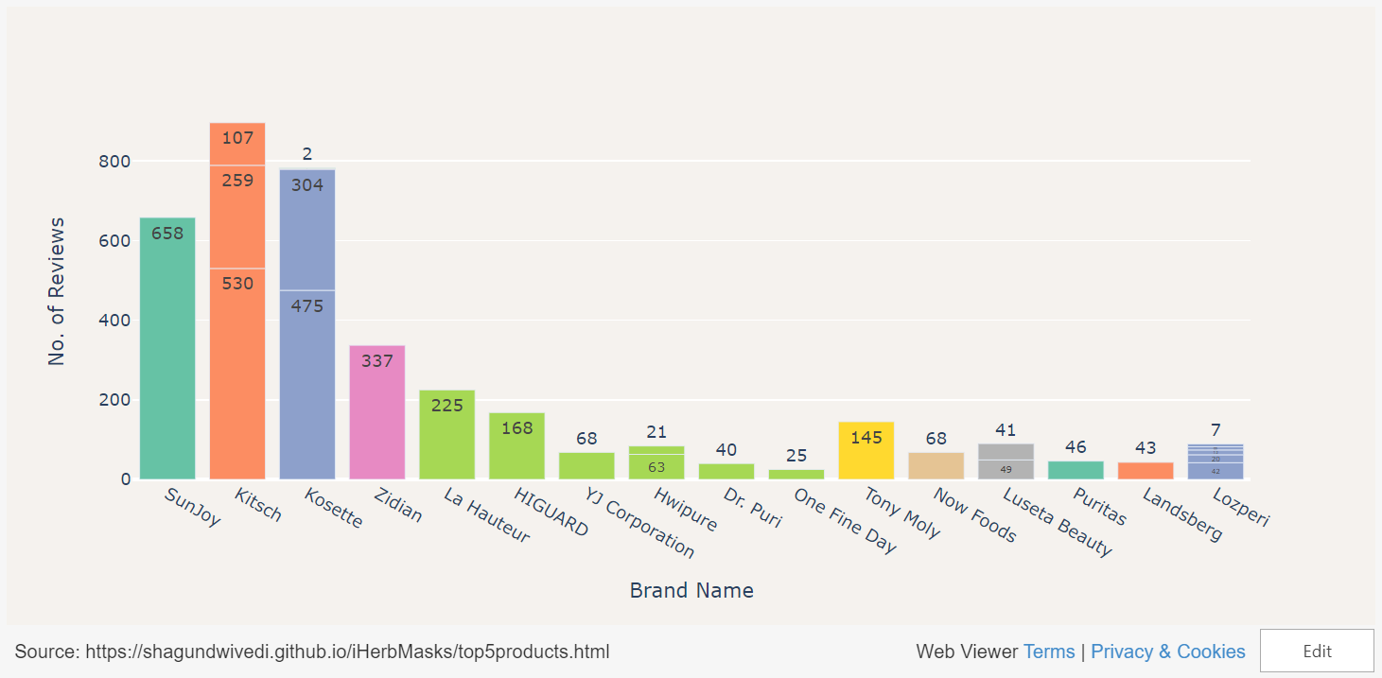
Popularity Based on Number of Reviews
01. Most Popular Masks
Intentionally Left Blank
Link: https://shagundwivedi.github.io/iHerbMasks/top5products.html

Slide 8
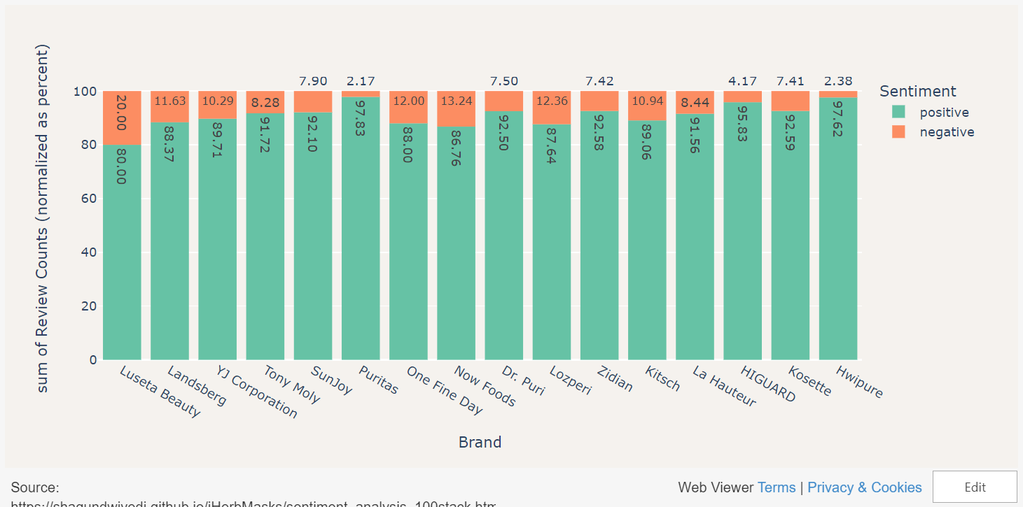
Sentiment Analysis of the Reviews
01. Most Popular Masks
Intentionally Left Blank
Link: https://shagundwivedi.github.io/iHerbMasks/sentiment_analysis_100stack.html

Slide 9
01. Most Popular Masks
Key Features of Five Most Popular Masks
As Mentioned in the Product Description
100% Cotton Reusable Face Masks:
Kitsch
Quantity: 3 Masks
Color: Blush, Neutral, Leopard (Most Popular)
Disposable Protective Face Mask:
Zidian
Quantity: 50 Masks
Nano Reusable Face Protection Mask:
Kosette
Quantity: 1 Mask
Size: Large, Medium (Most Popular)
Disposable KF94 (N95/KN95/FFP2) Mask:
La Hauteur, HIGUARD, One Fine Day: 1 Mask
Dr. Puri: 20 Masks
HwiPure: 25 Masks
YJ Corporation: For Children
KN95 Professional Protective Disposable Face Mask:
SunJoy
Quantity: 10 Masks

Slide 10
02
What do Consumers like most about the masks?
And, why?

Slide 11
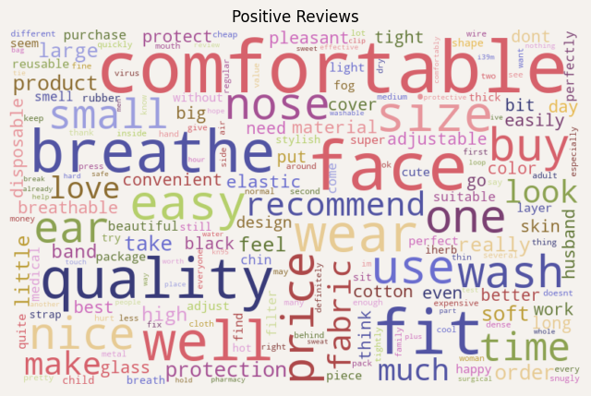
What do the Customers like about the masks?
02. Consumer Preferences
Let’s find what consumers like about the masks:
Through Text Analysis on positive user reviews, we deduce the following features:
Size:
Comfortable Fitting
on Face, Nose, Ear, Chin
Fabric material:
Cotton, cloth
Breathable
Washable, Reusable
Black, Soft, Beautiful, Stylish
Disposable
Band/Strap:
Wire
Elastic
Easy to Wear, Convenient
Price (probably low)

Slide 12
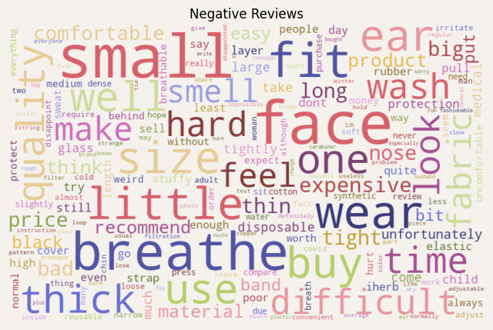
What do the Customers like about the masks?
02. Consumer Preferences
Let’s find what consumers don’t like about the masks:
Through Text Analysis on negative user reviews, we deduce the following features:
Size:
Small/Little/Tight Fitting
on Face, Nose, Ear
Material Quality:
Thin
Thick
Disposable
Not Breathable, Dense
Hard
Irritating
Sweats
Strap:
Elastic
Difficult to Adjust
Hurts
Price: Expensive
Glasses (probably fog up)
Everything!

Slide 13
03
What are the different profiles of consumers?
How can we segment them ?

Slide 14
Consumer Segmentation based on demographics
03. Demographic Segmentation
Demographic segmentation groups customers and potential customers together by focusing on certain traits such as age, gender, income, occupation & family status.
The most commonly used demographic segmentation factors are:
Age,
Gender,
Occupation,
Nationality,
Language
And/Or Religion.

Slide 15
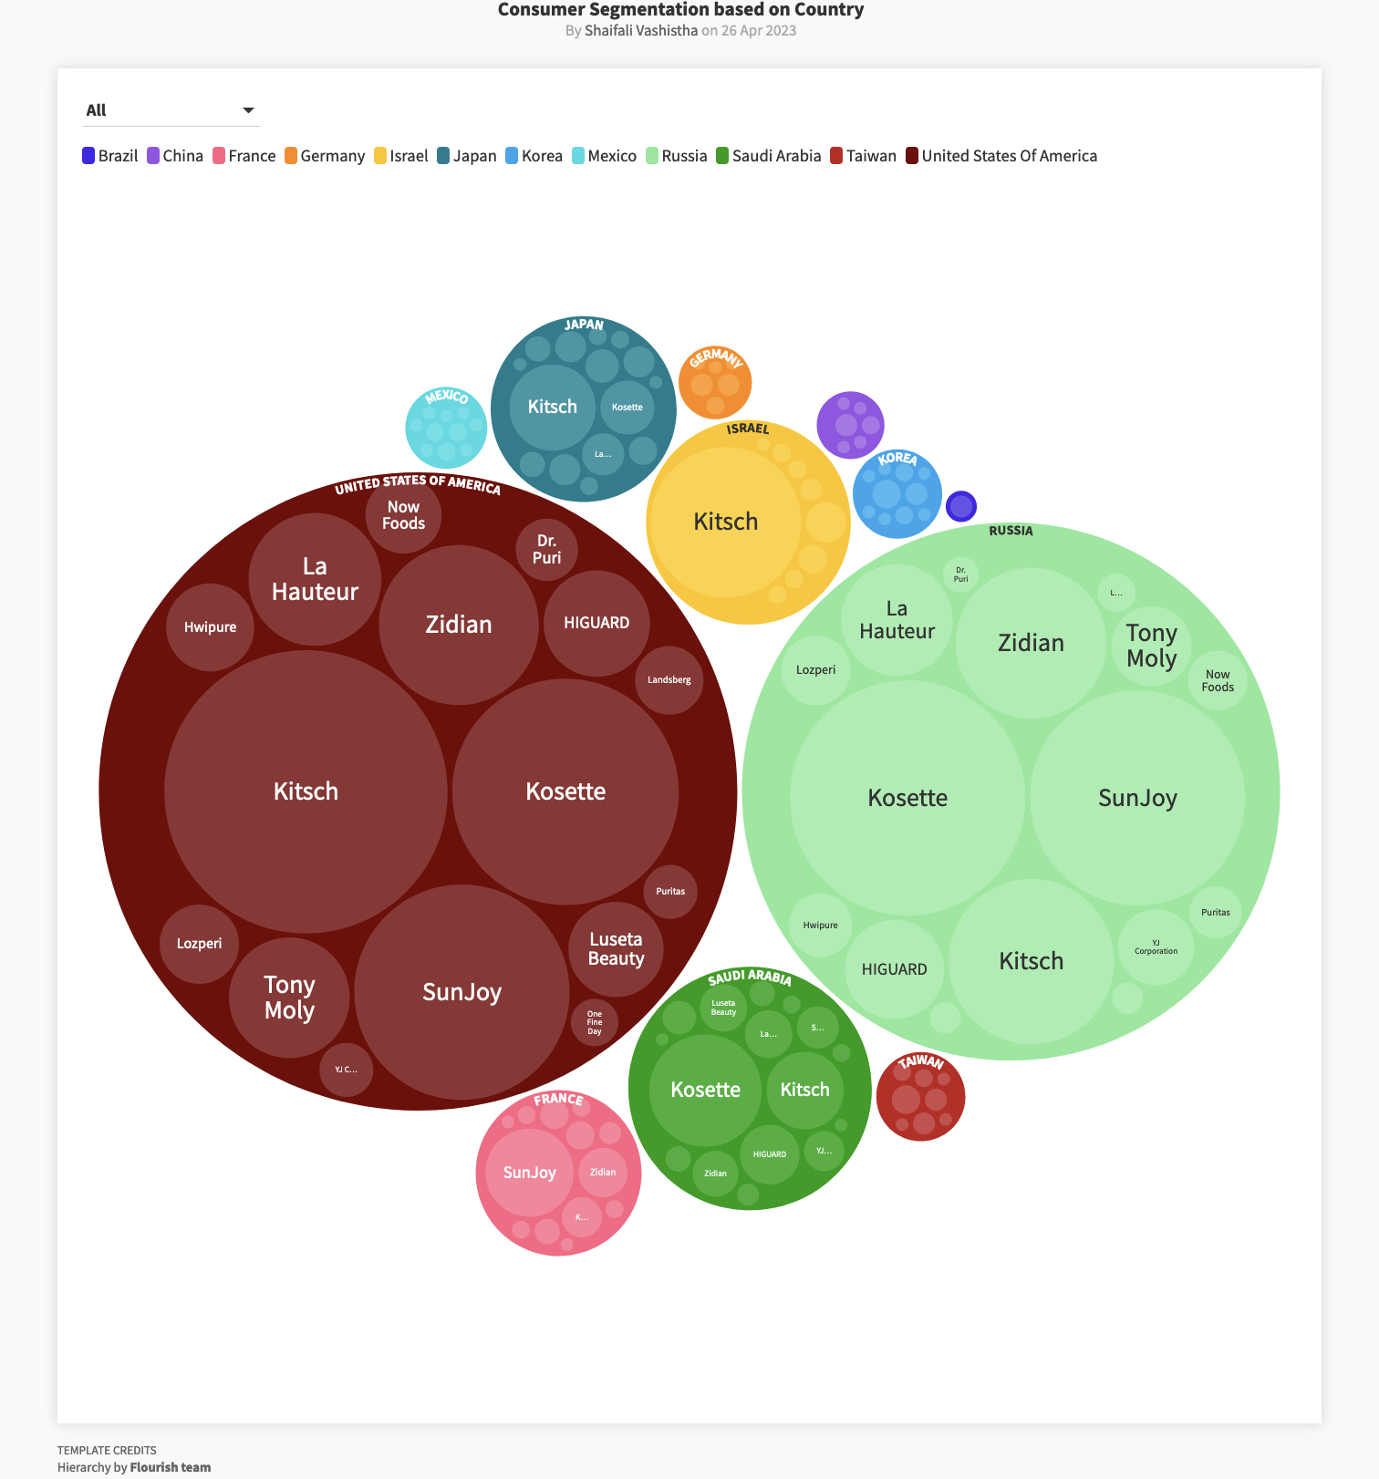
Segmentation by Countries (Region):
Demographic Segmentation of Consumers by countries(Ethnicity)

Slide 16
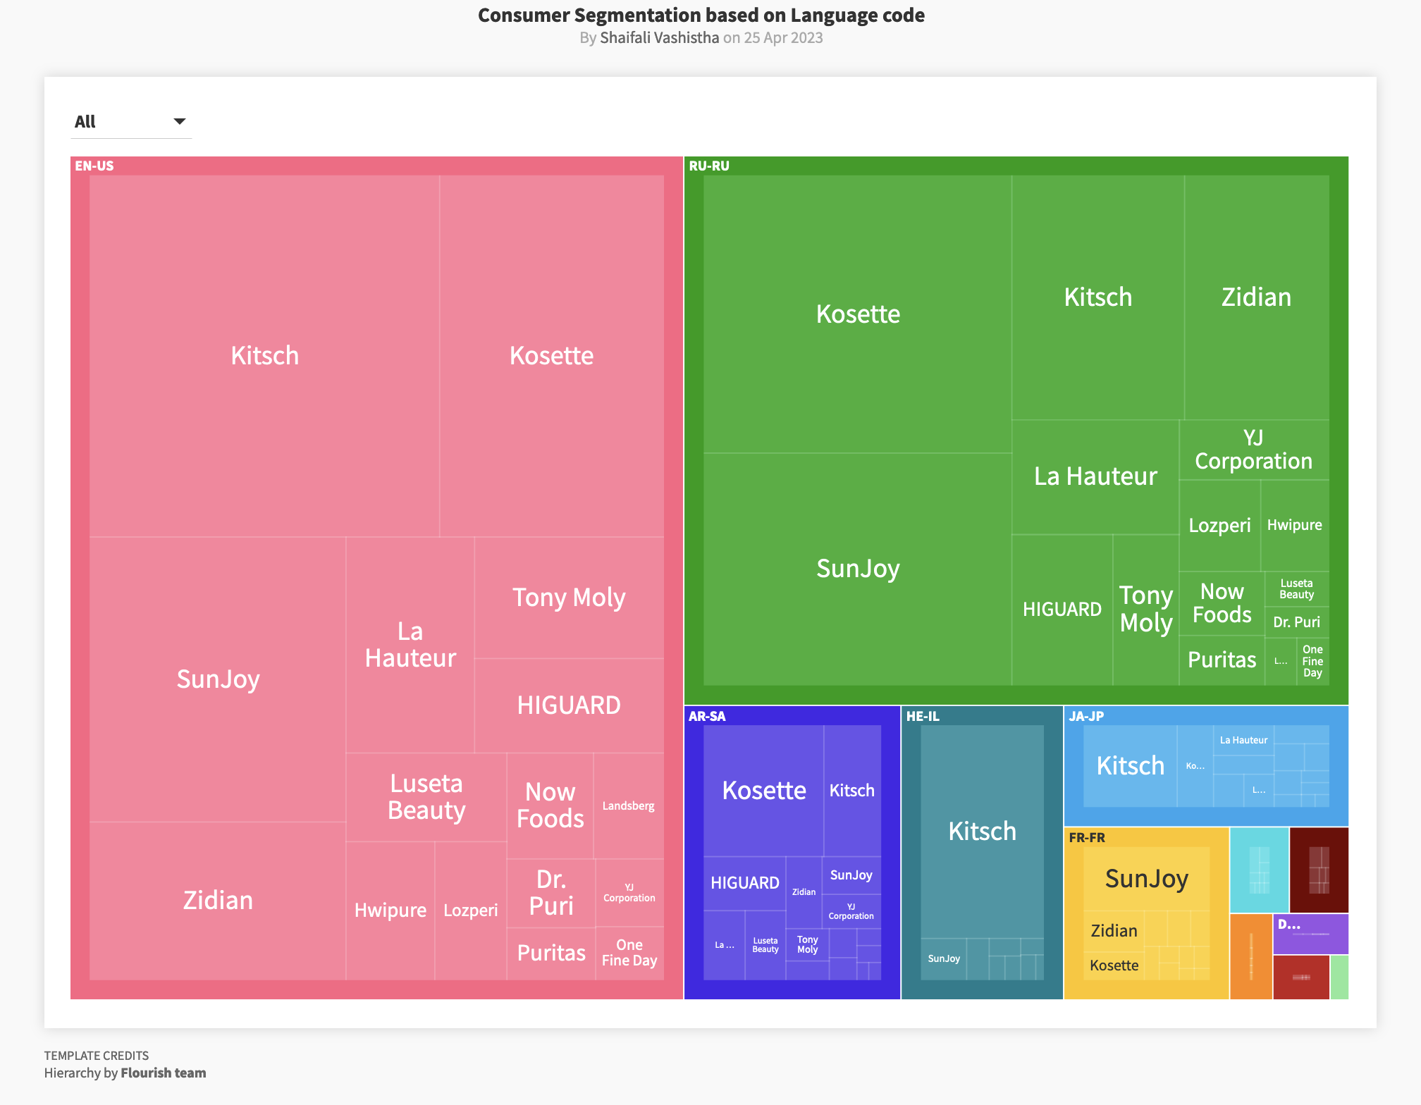
2. Segmentation by Language :
Demographic Segmentation of Consumers by Language

Slide 17
Consumer Segmentation based on behaviour
Consumer segmentation based on behaviour is a common approach used to categorize consumer based on the buying patterns or purchasing behaviour.
Behavioural segmentation can be based on questions like:
How much does a consumer spend on products?
How often does a consumer purchase?
What feature does a consumer see in the product?
What pattern is followed in purchase?
What choices do customers make during purchase?

Slide 18
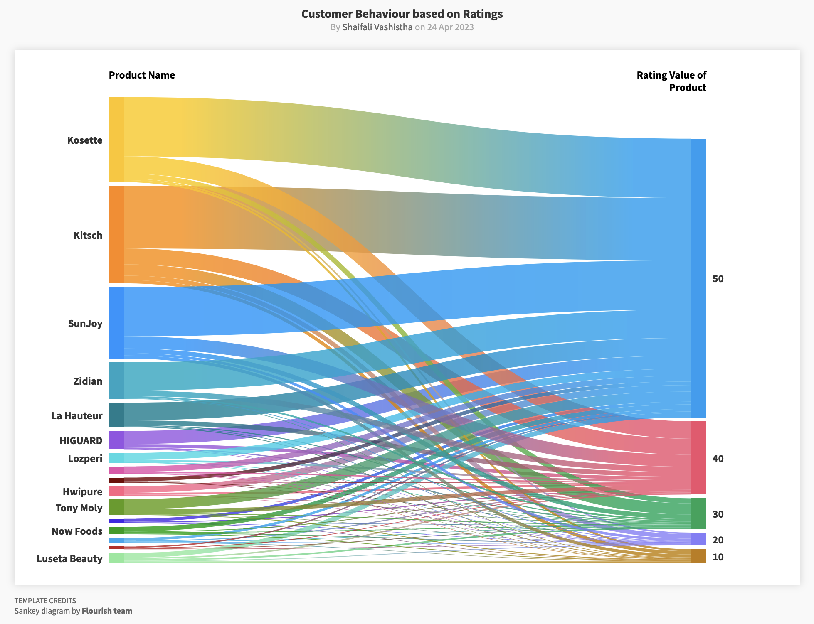
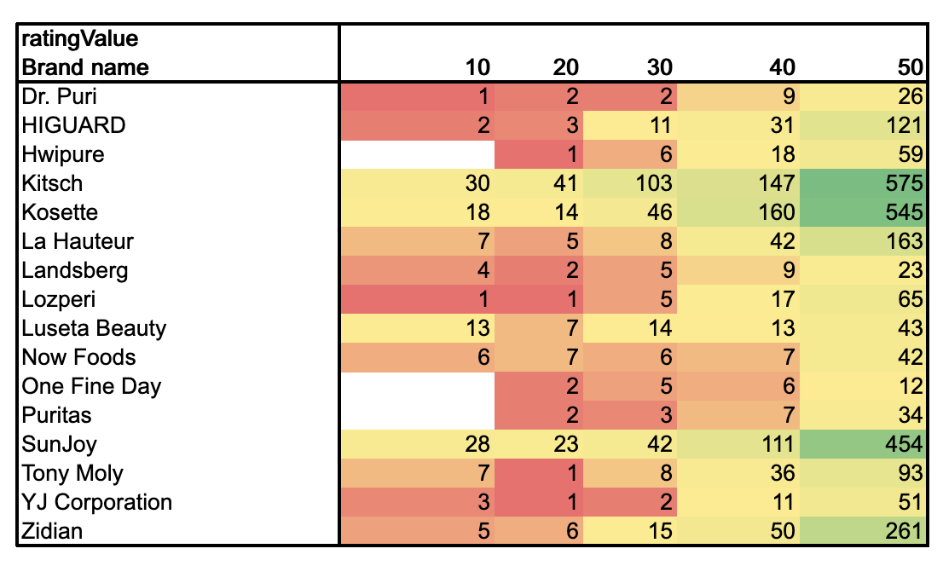
Behaviour of Consumer to buy a product based on its product ratings:
Customer Behaviour based on Ratings

Slide 19
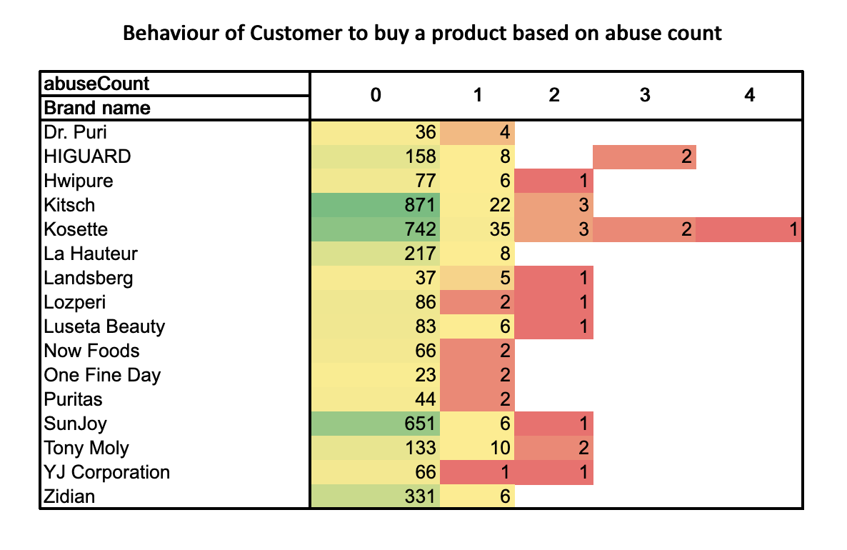
2. Behaviour of Customer to buy a product based on its Abuse Count:
Given dataset have a value abuse count for products of every brand.
Heat map shows the consumer’s behaviour to purchase brand with a lower abuse count.

Slide 20
Consumer Segmentation based on Preferences
Consumer segmentation based on preferences is used to categorize consumer based on the into groups who shares common interest and have same preferences in their purchases.
Consumer segmentation on the basis of preferences can be classified by questions like:
What are the consumer's preferred product features?
What are the consumer's preferred brand?
What are the consumer's preferred price?
What are the consumer's preferred colour?
What are the consumer's preferred product type?

Slide 21
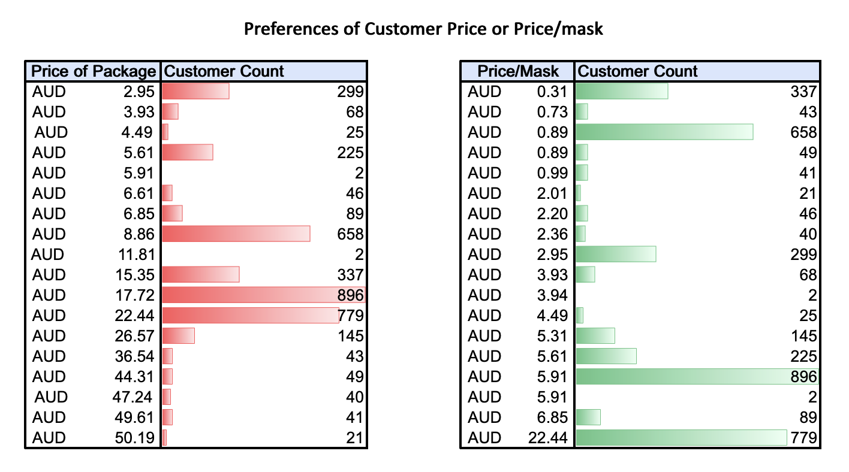
1. Preference of Customer Price or Price/Mask:

Slide 22
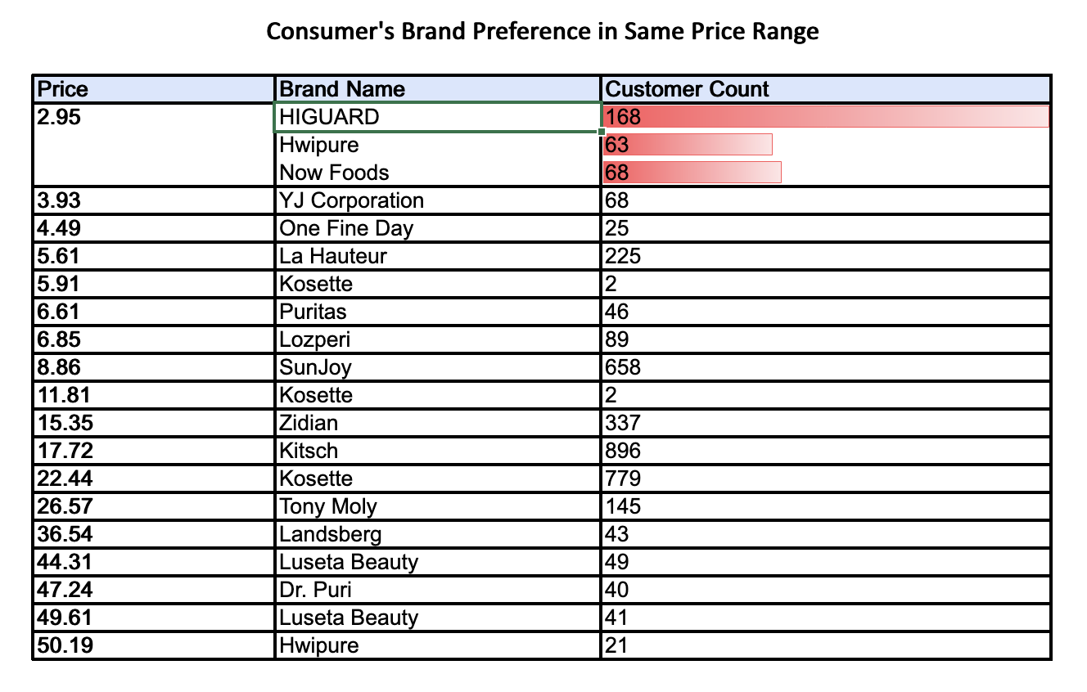
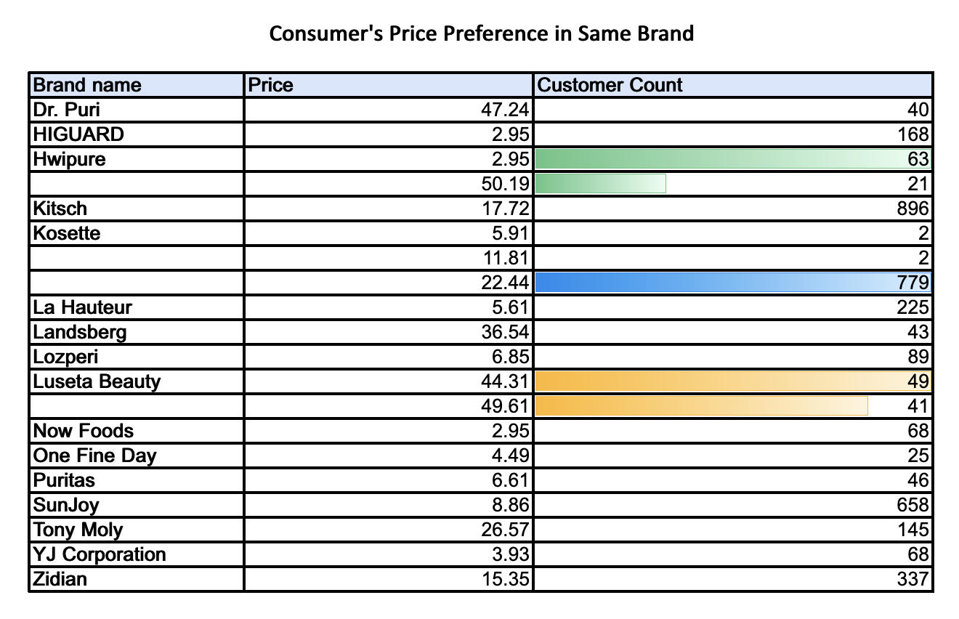
2. Consumer Brand Preference in Same Price Range:
Some Brands share common price range, and Some Package Price share common brands. But consumer shows different preference in both ranges.

Slide 23
04
How can additional data sources be used to gain more insights?
About type of
consumers buying different face masks

Slide 24
Additional Sources & More Insights
04. Additional Data
Data features like income, gender, age group, etc can help for better analysis of the data and get better insights on by classifying the consumer into groups.
Visualizing Income related data can help businesses identify pricing points that are most appealing to customers from different financial backgrounds.
Visualizing Age group related data can help understand the preferences of different generations and age brackets.
Visualizing Gender related data can assist in identifying the types of masks preferred by different genders.
Visualizing Occupation related data can be used to identify preferences of consumers in certain professions.

Slide 25
Additional Sources & More Insights
04. Additional Data
Visualizing multiple data sources can help to get a more comprehensive understanding identify opportunities to create products and marketing campaigns that cater to specific consumer groups, leading to greater success and profitability.
Using more data sources can help us gain a bigger picture of the variables affecting customers’ purchase decisions, so that businesses can gain a more comprehensive understanding of their target market, allowing them to make data-driven decisions that lead to greater success and profitability.

Slide 26
05
Key findings and implications of this analysis
For the client's marketing strategy and R&D department?

Slide 27
05. Key Findings
Most popular face masks in the store are:
Based on reviews - Puritas & Hwpure
Material - most popular masks are cotton based or disposable materials.
Implication - The client should focus on producing more masks with similar features and price range to meet the demand of customers.
Consumers like most popular face masks due to the following reasons - Comfortable fit, Breathable fabric, Stylish design, Good value for money.
Implication - The client should emphasize these features in their marketing campaigns to attract more customers.
Consumers don't like - Small, thick, hard to breathe, foggy masks.
Implication - The client should not emphasize these features in their
marketing but can focus on making fogg resistant masks

Slide 28
05. Key Findings
Different profiles of consumers who buy face masks can be segmented based on their demographics, behaviors, and preferences:
Demographics - Ethnicity & Language
Behaviors - Type of brands preferred in particular region.
Implication - The client should create targeted marketing campaigns for each segment to increase customer engagement and retention.
Additional data sources, such as location and occupation, can provide more insights into the type of consumers buying different face masks:
Location - Urban vs. Rural
Occupation - Healthcare workers, Teachers, and Students
Implication - The client should conduct more market research to understand the needs and preferences of different consumer segments based on their location and occupation. This can help the client to develop new products and marketing campaigns to meet the specific needs of these segments.

Slide 29
06
What are the constraints and improvements to the analysis?
How can we address them ?

Slide 30
“Constraints in data analysis are like a budget - they may limit your resources, but they can also encourage you to be more creative and efficient in your analysis.”

Slide 31
06. Analysis and Constraints
Constraints
1. Data quality: The analysis is only as good as the quality of the data. We have tried our best to clean the data and pre-process it. However, it is always possible to improve the dataset further.
2. Sample size: The sample size used for the analysis may not be representative of the overall population. A larger sample size can help to reduce the impact of outliers and provide more accurate insights.
3. Bias: The data may have inherent biases, such as selection bias or measurement bias. This can affect the accuracy of the analysis and lead to incorrect conclusions. More information about the collection of the dataset would have been helpful.
4. Less variables: The data does not necessarily include all relevant variables that could impact the analysis. For example, there may be other factors that influence purchasing behavior, such as age, gender, or income.
5. External factors: The analysis does not account for external factors that could impact the results, such as changes in the economy, social trends, or political events.

Slide 32
06. Analysis and Constraints
Possible Improvements
1. Collecting additional data from more sources: Collecting more data would provide a larger sample size and increase the accuracy and reliability of the analysis. It would have been useful to collect data from other sources to add with the existing data.
2. Improved Data Cleaning: Further cleaning of the data would have helped to further remove any inconsistencies and errors that may affect the analysis.
3. Advanced Analytics: We have used machine learning algorithms and natural language processing models for our analysis. More use of these could provide even more insights into the consumer behavior and patterns.
4. Using Other Visualization Methods: We have used simpler visualisations like bar charts, but maybe some other, more complex, visualizations could have not just helped to represent the data in a more user-friendly and accessible format but also given us an improved understanding of the dataset.

Slide 33
07
What are some extra features that could have helped us gain a few more valuable insights?

Slide 34
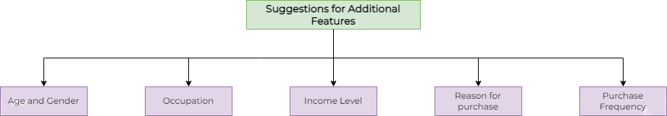
07. Suggestions
Additional Features that could lead to a better analysis

Slide 35
List of references
https://instapage.com/blog/demographic-segmentation/
https://m2.material.io/design/communication/data-visualization.html#selecting-charts
https://www.yieldify.com/blog/demographic-segmentation-ecommerce-marketing/
https://www.yieldify.com/blog/behavioral-segmentation-definition-examples/
https://clevertap.com/blog/behavioral-segmentation/

Slide 36
Thank You!

